Slide 1
An Introduction to Elliptic Curves
ATM Conference, Telford
Jonny Griffiths, April 2011

Slide 2
10³+9³=12³+1³= 1729
x³+y³= 1729
Symmetrical about y = x
x³+y³=(x+y)(x²-xy+y²)

Slide 3
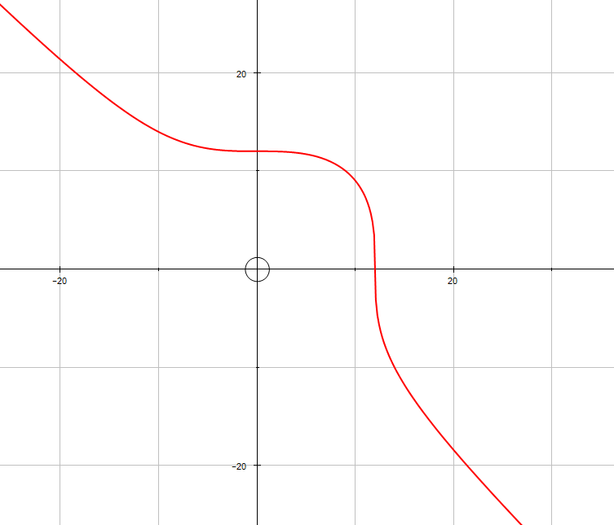

Slide 4
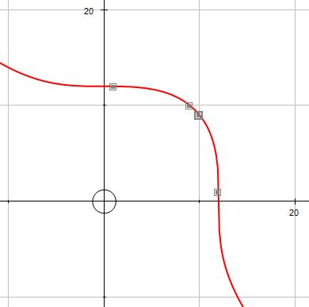
(1,12)
(9,10)
(10,9)
(12,1)

Slide 5
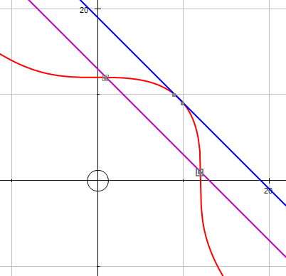

Slide 6
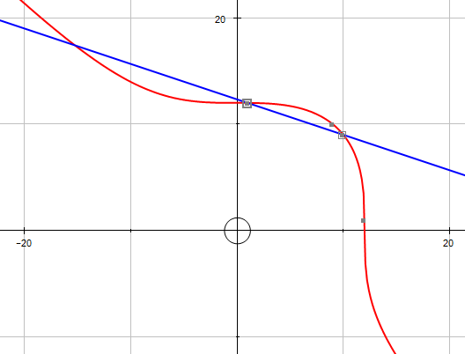

Slide 7
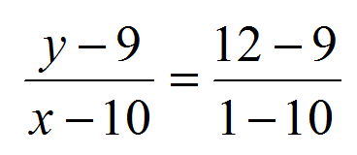
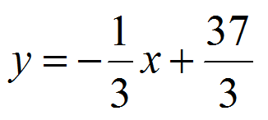
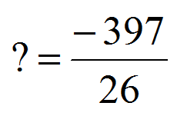
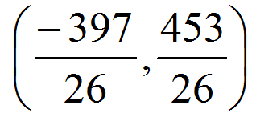

Slide 9
Associativity?

Slide 10
ax + by + c = 0
Straight line
ax² + bxy + cy² + dx + ey + f = 0
Conics
Circle, ellipse, parabola, hyperbola,
pair of straight lines

Slide 11
ax³ + bx²y + cxy² + dy³
+ ex² + fxy + gy² + hx + iy + j = 0
Elliptic curves
UNLESS
The curve has singularities;
a cusp or a loop
or it factorises into straight lines...
Some higher power curves too.

Slide 12
Any elliptic curve can be transformed
into Weierstrauss Normal Form
Y² = X³ + aX + b
using a birational map;
that is, you can get from the original curve to this normal form
and back again using rational maps.
In this case we say the curves are ISOMORPHIC.

Slide 13
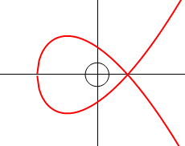
For curve to be non-singular, we require the discriminant to be non-zero.
Δ = 4a³ + 27b²
a = -3, b = 2, Δ = 0.

Slide 14
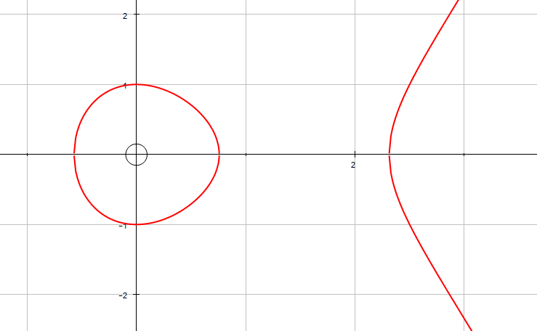
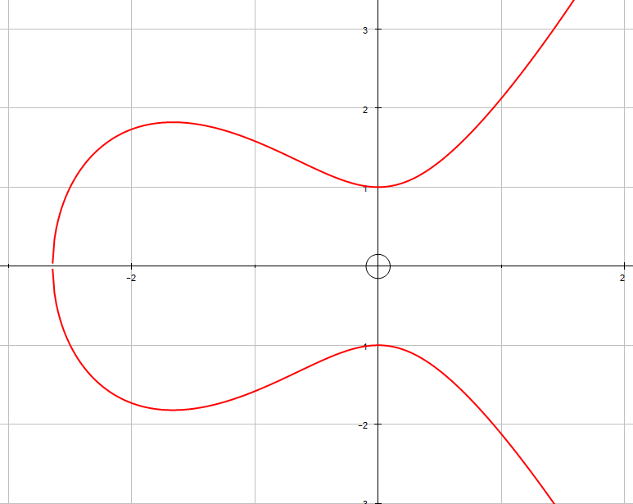
Y² = X³ + aX + b
a = -2.5
b = 1
a = 2.5
b = 1

Slide 15
If two elliptic curves are isomorphic, then their j-invariants are the same.
j(E) = 4a³/Δ.
(Converse is true over C
but not quite over Q;
a few extra conditions required!)

Slide 16
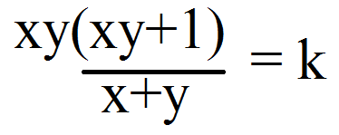
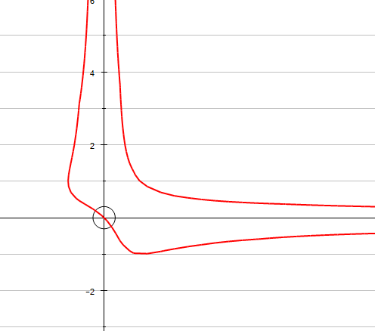
For example...
Transforming to Normal Form

Slide 17
This becomes...

Slide 19
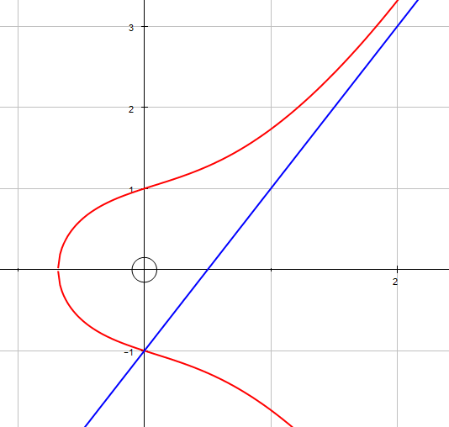
Where does a straight line
cross our elliptic curve
in normal form?
We are solving simultaneously
y = mx + c, y² = x³ + ax + b
which gives
x³ - m²x² + x(a - 2cm) + b - c² = 0

Slide 20
This is a cubic equation with at most three real roots.
Note; if it has two real roots,
it must have a third real root.
So if we pick two points on the curve,
the line joining them
MUST cut the curve in a third point.

Slide 21
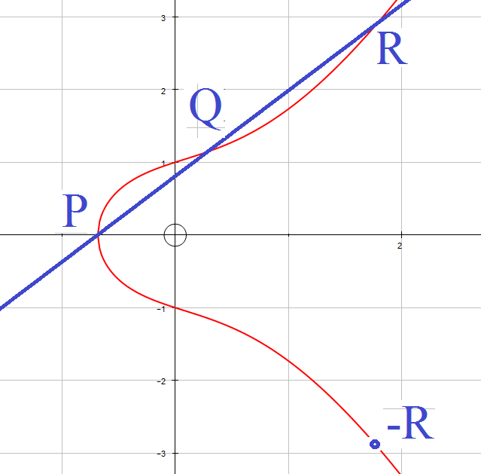
P+Q+R=0
P+Q=-R

Slide 22
Amazing fact...
The set of points on the curve
together with this addition operation
form a group.
Closed – certainly.
We want P and –P to be inverses.
So P + -P = 0, and we define 0,
the identity here, as the point at infinity.

Slide 23
Associativity?
Geogebra demonstration

Slide 24
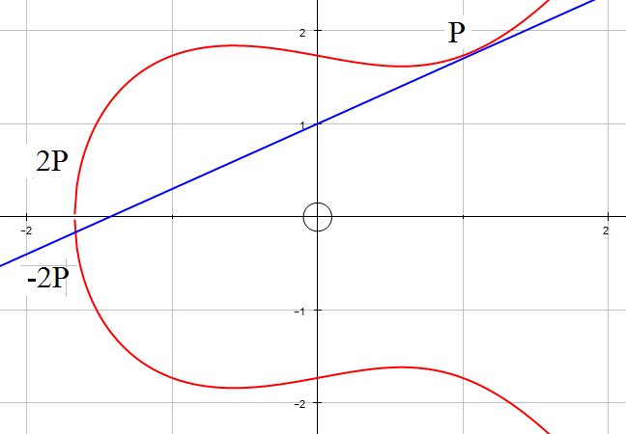
We can form multiples of a point by taking the tangent at that point.

Slide 25
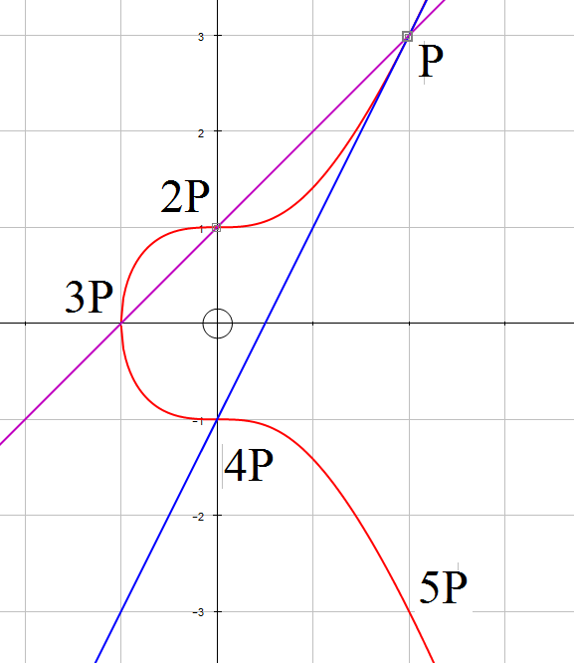
Sometimes we find that kP = 0. In this case we say that P is a torsion point.
y²=x³+1
6P=0
P is of order 6

Slide 26
Notice that if m, c, a and b are rational, then the set of rational points on the curve form a group.
Closed – certainly.
x³ - m²x² + x(a - 2cm) + b - c² = 0
If two roots are rational, the third must be.
Inverses and identity as before

Slide 27
Mordell Theorem (1922) Let E be an elliptic curve defined over Q. Then E(Q) is a finitely generated Abelian group. (Mordell-Weil Theorem [1928] generalises this.)

Slide 28
Siegel’s Theorem (1929)
If a, b and c are rational,
(and if x³+ax²+bx+c =0
has no repeated solutions),
then there are finitely many integer points on
y² = x³ + ax² +bx + c.

Slide 29
The Nagell-Lutz Theorem (1935-37)
If E(Q) is the elliptic curve y² = x³ + ax + b,
where a and b are in Z,
then for all non-zero torsion points P = (u, v),
u, v are in Z,
If P is of order greater than 2,
v² divides 4a³ + 27b²
3. If P is of order 2, then v = 0 and u³ + au + b = 0.

Slide 30
The Mordell – Weil Theorem implies that E(Q) is isomorphic to E_{torsion}(Q) ⊕ Z^{r}
The number r is called
the RANK of the elliptic curve.
How big can the rank be?
Nobody knows.

Slide 31
Largest rank so far found; 18 by Elkies (2006)
y² + xy = x³
− 2617596002705884096311701787701203903556438969515x
+ 5106938147613148648974217710037377208977
9103253890567848326775119094885041.
Curves of rank at least 28 exist.

Slide 32
Mazur’s Theorem (1977) The torsion subgroup of E(Q) is isomorphic to Z/nZ for some n in {1, 2, 3, 4, 5, 6, 7, 8, 9, 10, 12} or to Z/2nZ ⊕ Z/2Z for some n in {1, 2, 3, 4}.

Slide 34
An elliptic curve is of genus 1 (a torus.)
A conic is of genus 0.
Genus > 1, hyperelliptic curves.
Faltings Theorem (1983)
A hyperelliptic curve has finitely many
rational points.

Slide 35
Let C denote the hyperelliptic curve defined by y² = x⁹ − 6x⁸ + 31x⁷ − 81x⁶ + 177x⁵ − 176x⁴ − 9x³ + 107x² + 19x + 1 . Then C(Q) = {0, (1, ±8), (0, ±1)}

Slide 36
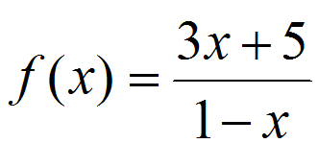
x = 3, k = -14
3x⁴+19x³-33x²-139x-42=0

Slide 37
x = 3, k = -14
3x⁴+19x³-33x²-139x-42=0
Other roots are -7, -2, -1/3.

Slide 38
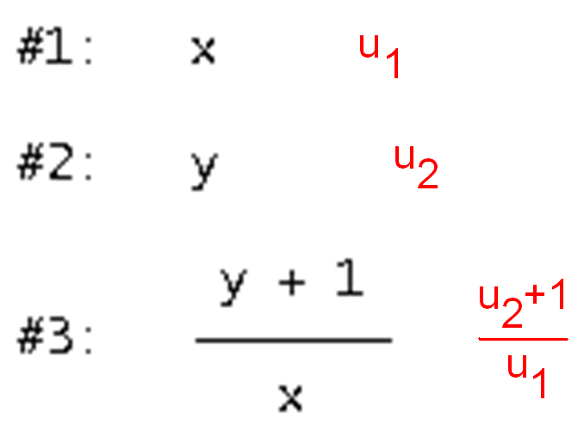

Slide 40
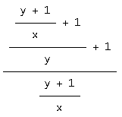

Slide 42
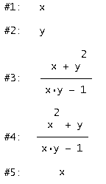
Period Three:
Period Two:
x
Period Four:
Period Six:

Slide 43
If we insist on integer/rational coefficients…
Period Seven and over: nothing
Why should this be?

Slide 44
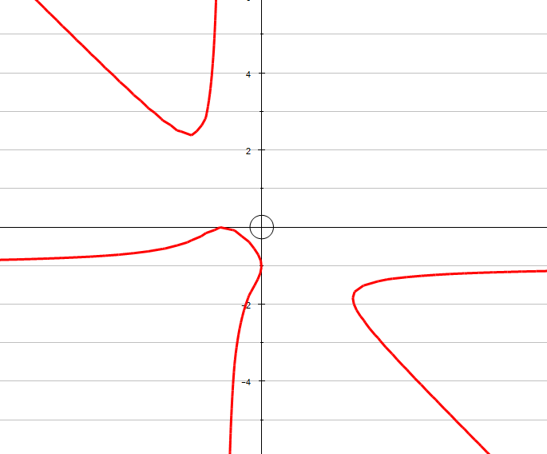
An elliptic curve!

Slide 45
Choose A = (a, b) to be on the curve, which gives k.
X = (0,-1) is a torsion point of order 5.
What happens if we repeatedly add X to A?
We expect to get back to A, and we do.
But we get this sequence of points...
The recurrence that built the curve is linked geometrically to adding a torsion point on it.

Slide 46
Could equally well add the terms of the period-5 cycle -
gives almost exactly
the same elliptic curve.

Slide 47
Can we do this for other periods?
Consider the example we had earlier:
Is a periodic recurrence relation,
period 3.

Slide 48
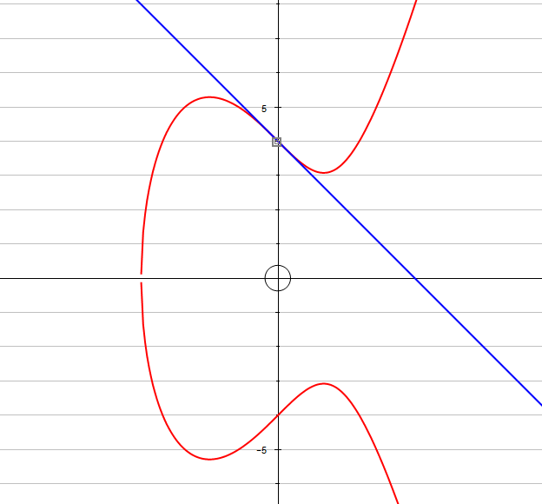
PARI- this has a torsion point of order 3
when X = 0.

Slide 49
If we take a point (p,q) on
map to our cubic, add X and then map back, we get:
(p, q) maps to (q, -(pq+1)/(p+q))
The recurrence that built the curve is linked geometrically to adding a torsion point on it.

Slide 50
Period-4 cycle
PARI- elliptic curve with 4-torsion.

Slide 51
Period-6 cycle
PARI- elliptic curve with 6-torsion.

Slide 52
Google ‘jonny griffiths msc’
For more information

